Slide 1
Growing with Gaming
A Data Analysis of Steam Games

Slide 2


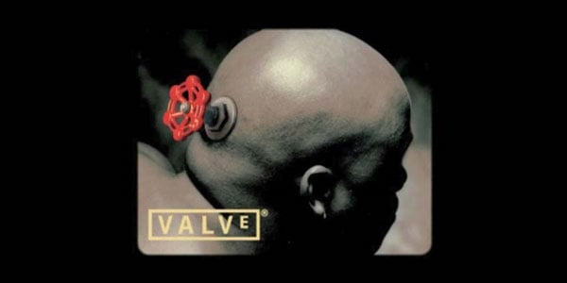
Ever See this Logo?

Slide 3



Steam Powered
For those who don’t know,
Steam is a video game platform created by Valve Corporation (their logo in previous slide)
Although Valve does other fields, Steam is under their umbrella. The Steam Logo
Steam holds a wide amount of video games from the deep sea of many video game developers. (think of it as the equivalent of the apple store but for video games)
They range from triple A title’s
To smaller teams of developers
Triple A simply means a corporate studio that is typically known just by their studio name and popular games they release.

Slide 4

The Good Stuff
The question(s) to be answered is “Has price of video games changed over time?”
“Does price affect positive ratings?”
And other questions answered and speculations from the data
WARNING: THIS NEXT SLIDE MIGHT BE TOO COOL FOR SOME PEOPLE TO HANDLE

Slide 5


Slide 6



OKAY WHERE’S THE DATA??
Wasn’t that cool? Action.
The next slides contain the graphed data, lets dive in

Slide 7
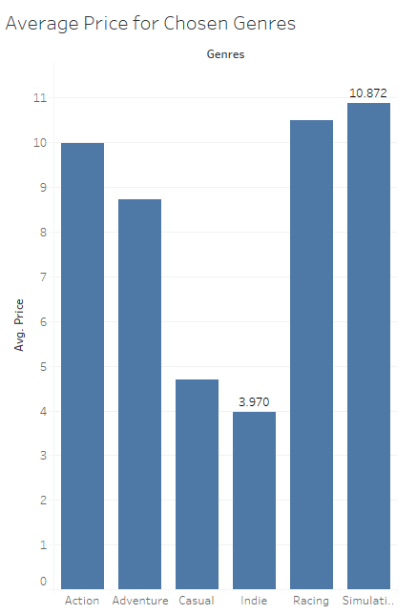
Average Prices from Chosen Genres

Slide 8
Big Three
I took the three genres with the highest average price and dived a little deeper. These three graphs are price changes over the years

Slide 9
Brief 2005 History
Steam was made in 2003 and ONLY for Valve games until 2005. Hence the dip in the next slide, the data only shows Valve games prior to 2005, everything else data-wise and game-wise came after the dip where Steam became an actual online store.

Slide 10
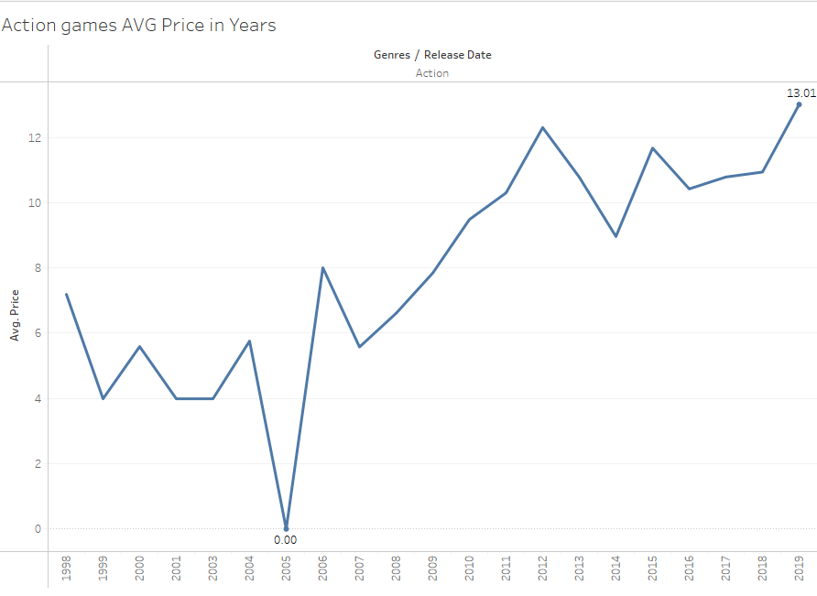

Slide 11
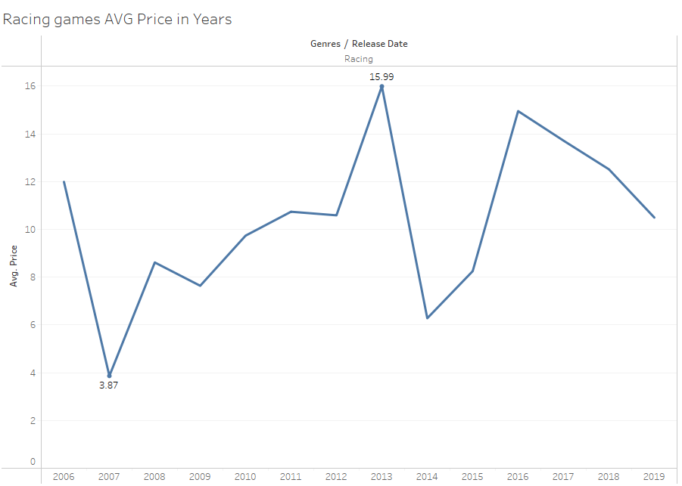

Slide 12
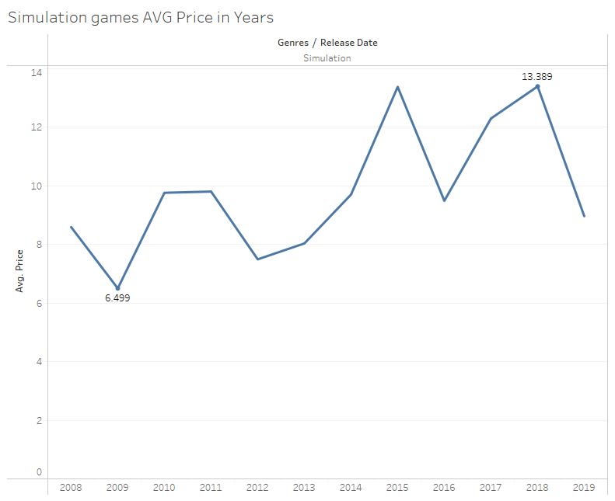

Slide 13
These Graphs are Changes over Months

Slide 14
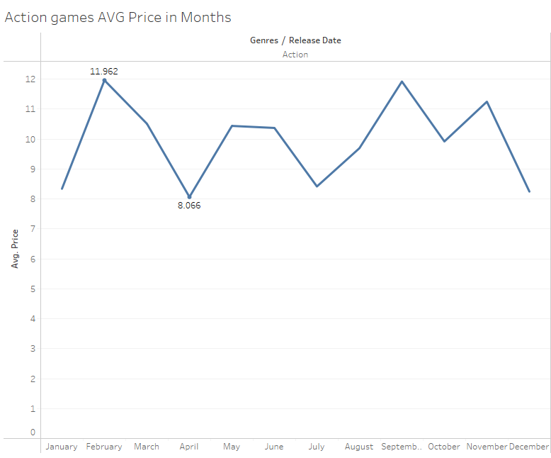

Slide 15
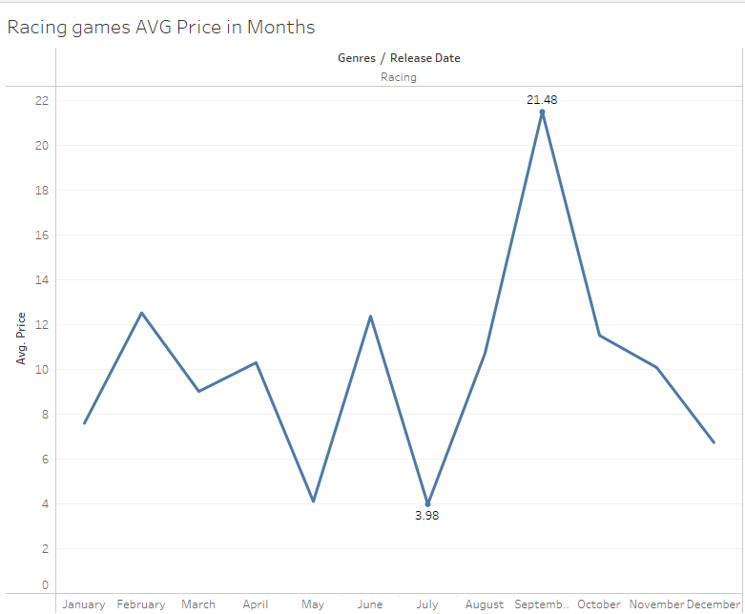

Slide 16
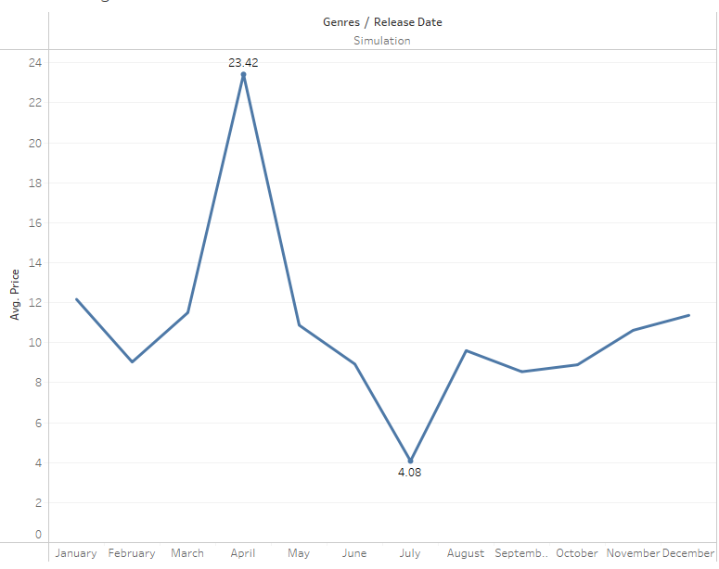

Slide 17
Last set of slides comparing price with positive ratings

Slide 18
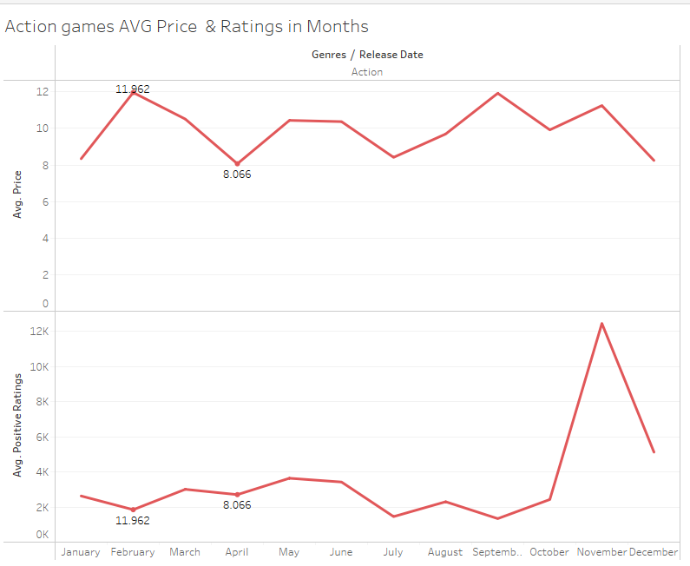

Slide 19
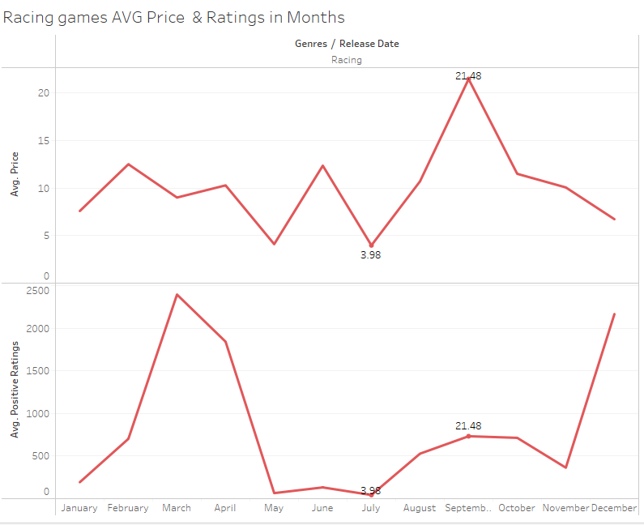

Slide 20
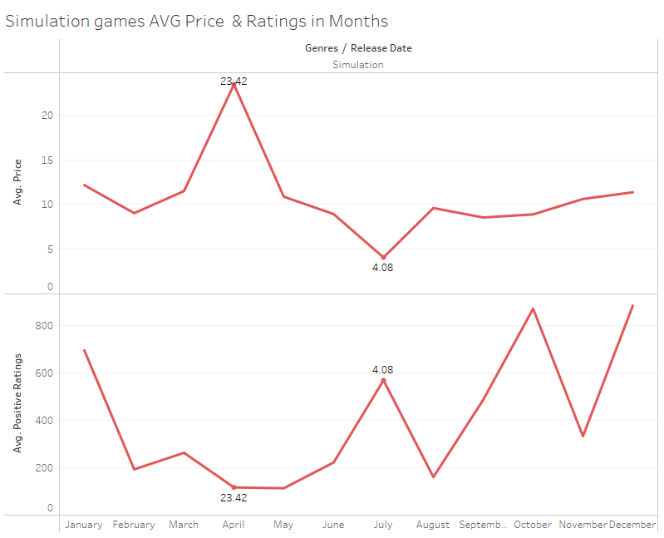

Slide 21
Concluding
The Action genre appears to be going up steadily with it’s average price yearly, this could be because it is the most popular. While Racing and Simulation appear to be heading on a downwards trend for yearly average price, people might not be buying as much, however there are drastic spikes, so they may fluctuate a lot they could still be going up, just in a bigger spiked fashion, it’s only a matter of time before the next big spike furthering it forward. We can say price has changed over the years.
Although on a month-to-month basis, action seems to be more consistent to dip in the steam sales (Spring or Summer). Although Simulation doesn’t seem to have Spring sales one could assume, it still has a summer sale, Racing has both. Simulation and Racing stay at a consistent higher price in general. It also looks like Racing games have their big releases in the fall hence why their average price is higher.
We saw from the last graphs that it seems positive reviews seem to be higher when the price is lower, which honestly surprised me, I guess when people buy a game for a bargain it softens them up to review the game better. So, we can safely say, yes prices do affect positive ratings

Slide 22


Slide 23
SOURCES CITED
Some information about Steam - https://www.pcgamer.com/steam-versions/
Dataset - https://www.kaggle.com/datasets/nikdavis/steam-store-games
I DON’T OWN ANY LOGOS OR PICTURES ON THIS PRESENTATION, THEY WERE PULLED OFF THE INTERNET
This also was not sponsored by Valve nor is there any involvement with them – this is simply a project.

